Slide 1
Adaptive Routing for Saving Energy of Random shortcut Networks using Reinforcement Learning

Slide 2
Saving energy in random shortcut interconnection network
Nguyen Tien Thanh

Slide 3
Abstract
Random shortcut interconnection network has better scalability, smaller diameter and lower latency when compared to regular network topologies. But this topology still has question about saving its energy, both at simulation and prototype. In this proposal, I propose a traffic routing approach for saving energy mechanism based on on/off links and switches; this approach mechanism chooses subset of network to stay active and then turns off redundant links and switches. I hope my proposal can save up to 50% of network energy and therefore justify using random interconnection topology.

Slide 4

Introduction
Random shortcut network interconnection topology has better scalability, smaller diameter, lower latency when compared to regular network topologies [R5].
But it has question about saving energy, both at simulation and prototype.
Network devices consume up to 15% of data center’s energy [R1].

Slide 5
Introduction
IEEE Energy Efficient Ethernet standard (IEEE 802.3az) proposes power-saving mechanism by turning on/off links in a few microseconds [R6]
Given the recent advancement of IEEE 802.3az, a question arises how to choose a subset of network that can still route data to all nodes.
Many approaches concentrate on saving energy of torus [R2], Fat Tree [R3] or both of them [R4] by turning off redundant links and ports.
Finding optimal traffic routing solution (that satisfies traffic constraints) is a NP-complete problem [R3]

Slide 6
Content
Introduction
Background
  NP-Complete and formal method
  Software Defined Network
  Machine learning
Methodology
Related Work
Conclusion

Slide 7

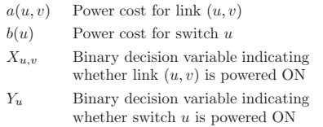
2. Background
2.1 NP-complete and formal method
Heller [R3] modelled total network energy consumption:
(1)
Minimizing (1) while satisfying all traffic constraints is NP-complete problem.
Authors proposed a formal method in order to produce solutions closest to optimal but this method has complexity O(n^{3.5}).
Authors then proposed two heuristic methods with complexities O(n²) and O(n) respectively.

Slide 8
2. Background
2.1 NP-complete and formal method
Heller [R3] modelled total network energy consumption:
(1)
Minimizing (1) while satisfying all traffic constraints is NP-complete problem.
Authors proposed a formal method in order to produce solutions closest to optimal but this method has complexity O(n^{3.5}).
Authors then proposed two heuristic methods with complexities O(n²) and O(n) respectively.

Slide 9
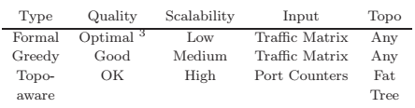
2.1 NP-complete and formal method

Slide 10
2.1 NP-complete and formal method
But authors mention nothing about discrepancy of network energy consumptions between two heuristic methods and formal method.
Keep in mind that the formal method is not the best solution, it has bounded percentage from optimal, configured to 10% [R3]

Slide 11
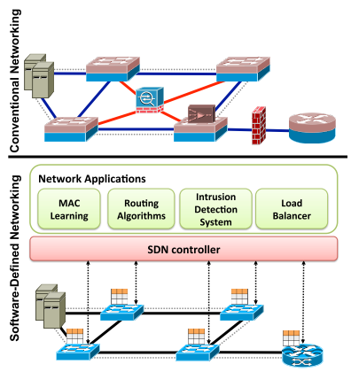
2.2. Software Defined Network
SDN is the hardware independent next generation networking paradigm in which networking device from any vendors could be controlled through SDN.
The openness, feasibility and programmability of SDN reduces the complexity to implement energy efficiency approaches in both hardware and software [R7].
In my opinion, SDN is the best solution for building simulator and prototype of energy-aware routing in data center networks.

Slide 12
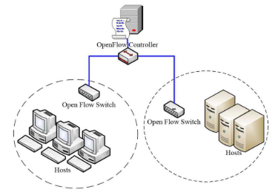
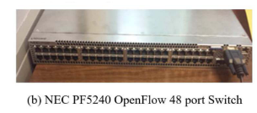
2.2. Software Defined Network
ElasticTree uses NOX, OpenFlow for its controller and Southbound API respectively. [R3]

Slide 13
2.2. Machine Learning

Slide 14
Problems

Slide 15
Conclusion
Random shortcut interconnection network has better scalability, smaller diameter and lower latency when compared to regular network topologies. But it still lacks a saving energy solution as this topology is applied to data center networks.
I am going to use traffic routing to maximize idle ports switches and links and then power them off. I expect a reinforcement learning to give an acceptable routing for this NP-complete problem. Flow table size
In future, a deep reinforcement learning could work better than other classic techniques for energy consumption prediction as scaling nodes of DCN.

Slide 16
References
[R1] A. Greenberg, et al. The Cost of a Cloud: Research Problems in Data Center Networks. In ACM SIGCOMM CCR, January 2009.
[R2] Andújar, F. J et al. Energy efficient torus networks with on/off links. Journal of Parallel and Distributed Computing, March 2019.
[R3] Heller, Brandon, et al. Elastictree: Saving energy in data center networks. Nsdi. Vol. 10. April, 2010.
[R4] Andújar, Franciso J., et al. "POWAR: Power-Aware Routing in HPC Networks with On/Off Links." ACM Transactions on Architecture and Code Optimization (TACO) 15.4 (2019): 61.
[R5] Koibuchi, Michihiro, et al. "A case for random shortcut topologies for HPC interconnects." 2012 39th Annual International Symposium on Computer Architecture (ISCA). IEEE, June, 2012.
[R6] Reviriego, Pedro, et al. "Performance evaluation of energy efficient ethernet." IEEE Communications Letters, September, 2009: 697-699.

Slide 17
References
[R7] Rawat DB, Reddy SR. Software defined networking architecture, security and energy efficiency: A survey. IEEE Communications Surveys & Tutorials. January, 2017
[R2] Andújar, F. J et al. Energy efficient torus networks with on/off links. Journal of Parallel and Distributed Computing, March 2019.
[R3] Heller, Brandon, et al. Elastictree: Saving energy in data center networks. Nsdi. Vol. 10. April, 2010.
[R4] Andújar, Franciso J., et al. "POWAR: Power-Aware Routing in HPC Networks with On/Off Links." ACM Transactions on Architecture and Code Optimization (TACO) 15.4 (2019): 61.
[R5] Koibuchi, Michihiro, et al. "A case for random shortcut topologies for HPC interconnects." 2012 39th Annual International Symposium on Computer Architecture (ISCA). IEEE, June, 2012.
[R6] Reviriego, Pedro, et al. "Performance evaluation of energy efficient ethernet." IEEE Communications Letters, September, 2009: 697-699.

